Slide 1

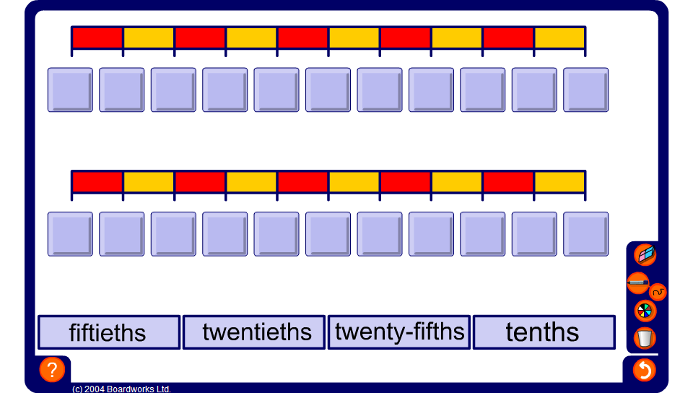


Comparing decimals and fractions
Notes:
Start by stating that any terminating decimal can be written as a fraction.
Who can tell me what a terminating decimal is?
Next draw the pupils’ attention to the counting sticks on the board.
The counting sticks can be configured to show ¹/₅₀s between 0 and ¹/₅, ¹/₂₅s between 0 and ²/₅, ¹/₂₀s between 0 and ¹/₂ and ¹/₁₀s between 0 and 1.
Start by selecting ¹/₁₀s between 0 and 1. Reveal the first number and the last number on the top counting stick (decimals).
You should know how to convert any number of tenths to a decimal already.
Go through these in random order.
Next, select ¹/₂₀s between 0 and ¹/₂.
The first value on this number line is 0 and the last value is 0.5. What will each step be worth? (0.5 ÷ 10 = 0.05)
Start by using the number line to count on in 0.05s from 0 to 0.5. Reveal the decimals on the line as you go through. Continue counting on in 0.05s. Stop at 2 and then count back to 0.
Next draw the pupils’ attention to the second number line.
This counting stick shows fractions in their lowest terms. Each fraction is equivalent to the decimal in the line directly above it. For example, 0.5 is equivalent to ½.
Click to reveal ½. Continue for other conversions.

